Slide 1

Prepared by Mushtaque Ali
Prepared by Mushtaque Ali

Slide 2
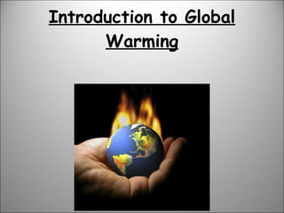

Slide 3
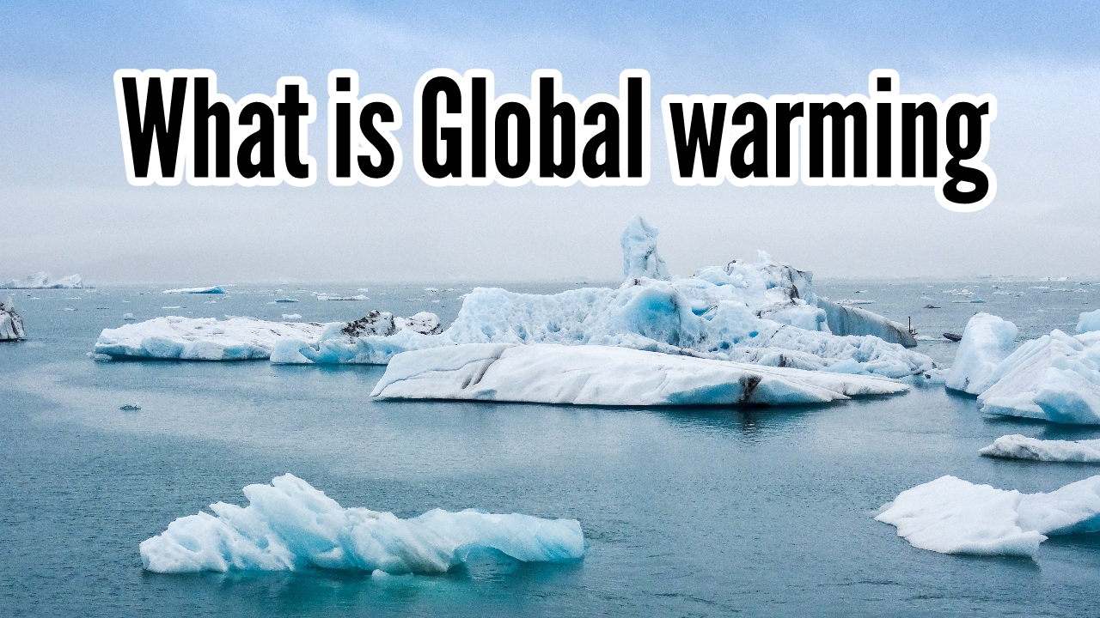
The long-term increase in Earth's average surface temperature due to human activities, primarily the release of greenhouse gases.

Slide 4
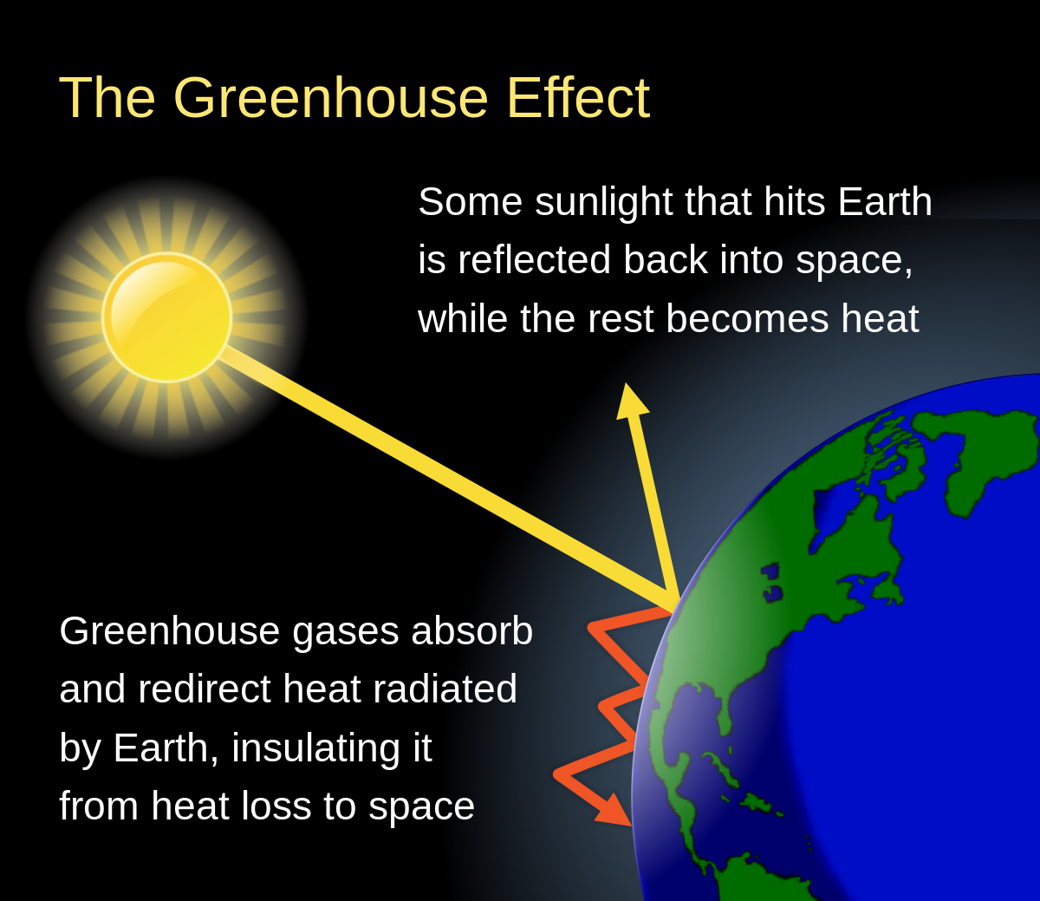

Slide 5
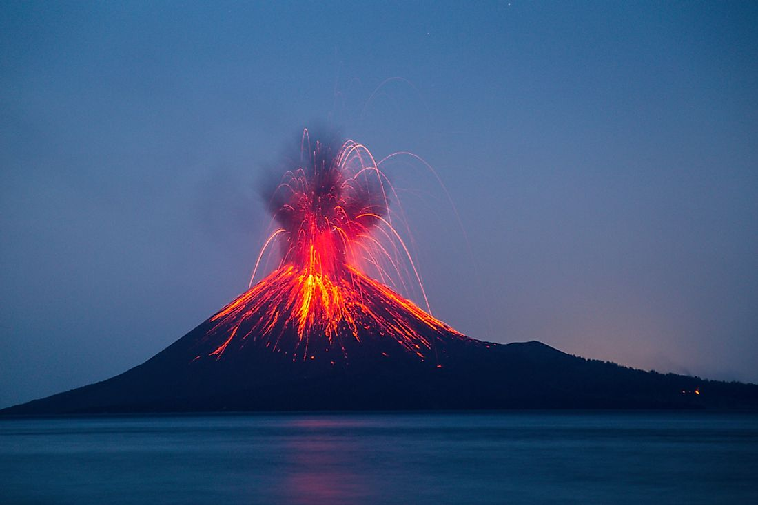
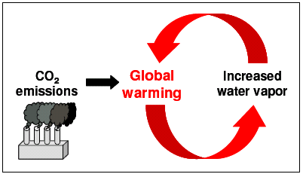
Causes of Global Warming
Natural Causes (5%)
Volcanoes
Water Vapors

Slide 6
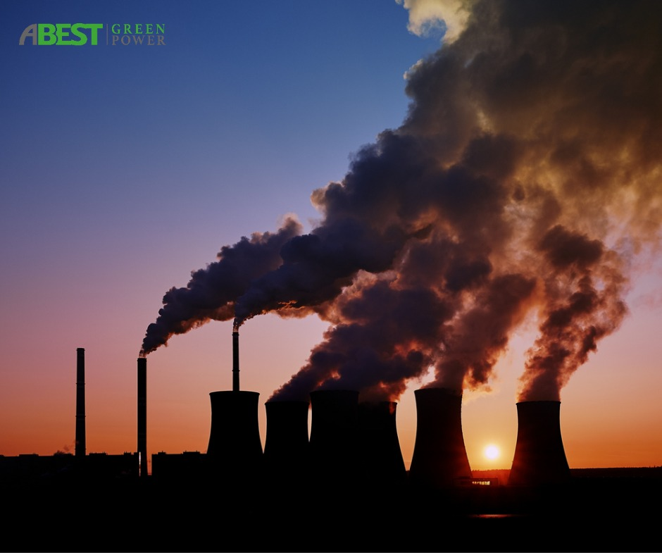
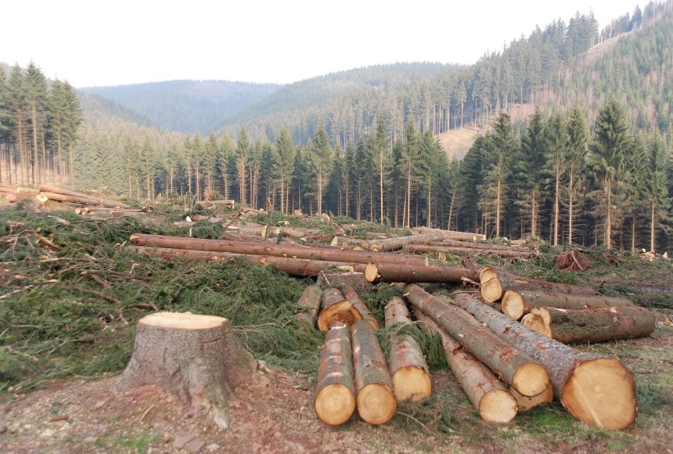
Human Factors Causes of Global Warming(95%)
Burning Fossil Fuels
Deforestation

Slide 7
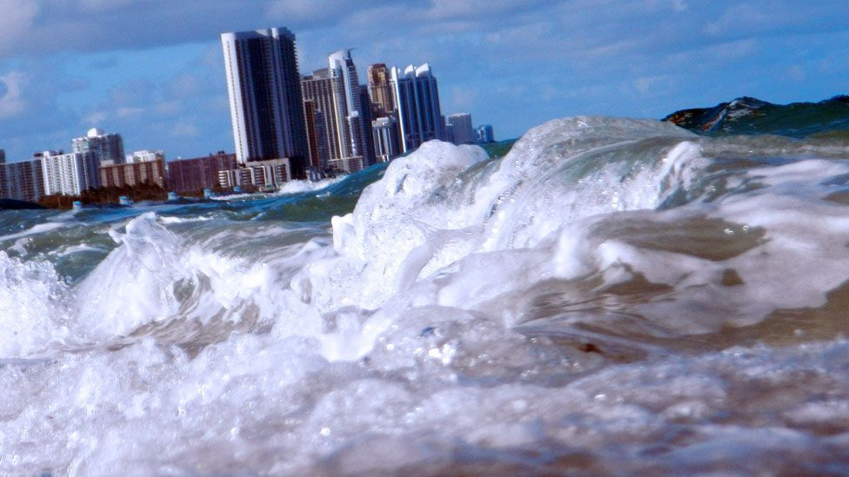

Impacts of Global Warming
Rising Sea levels
Health Risks

Slide 8
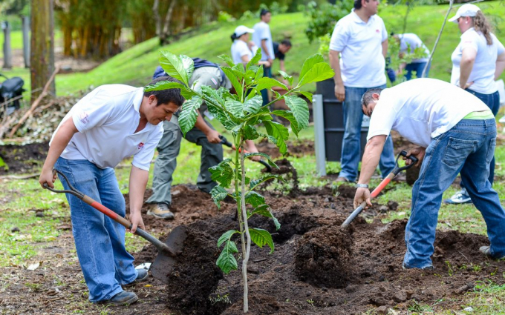
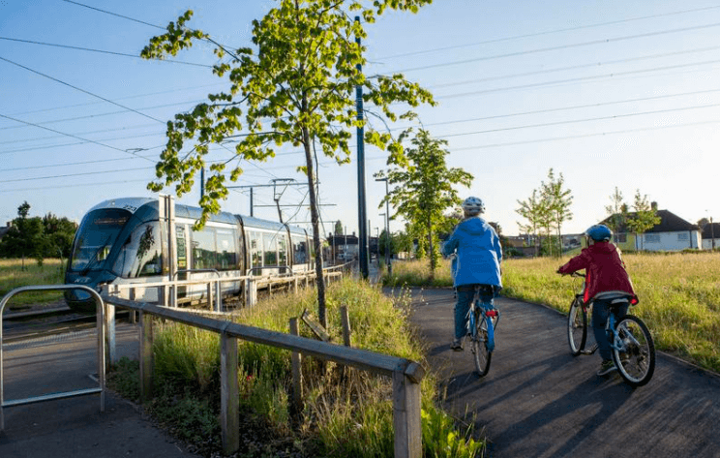
How to reduce global warming ?
Reforestation
Walk, cycle or take public transport

Slide 9


